Slide 1
Student Name

Slide 2
Dataset description
The dataset provided for this task is based on the Sales inputs identified based on their id. THE dataset contains various variable columns and headers that represent the store. The following are the variable headers
> SALES ID which is of variable type INTEGER
SALES which is of variable type FLOAT

Slide 3
Motivation
This task was motivated by the need to put into full potential the ability of data analysis and forecasting MODELS on real sales data in a bid to help key decisions makers in business arrive at meaningful decisions from the presentation and valuations of data as a problem.

Slide 4
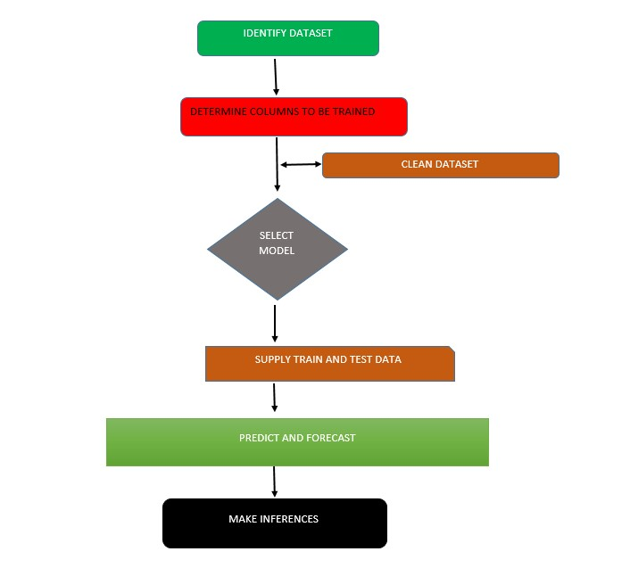

Slide 5
CORRELATIONAL MODEL
>Model is useful when trying to find relationship between two or more items in a set
> Good for visualising values that closely affect each other and are predictable in nature

Slide 6
ARIMA MODEL
The model is based on variable distribution over timed data
Easiest to work out the time distribution of interval occurrences over a given time
Its ability to predict future values makes it a strong application in the most sectors like Finance and economics

Slide 7
RNN MODEL
>Are most useful in building neural networks and establishing patterns between items in scope
> It would be the most preferred model among AI enthusiast and scientists who are trying to build deep learning models

Slide 8
RANDOM FOREST
>This model uses bagging algorithm to predict future outcomes
>each prediction made is classified into a “forest”/ node
>LATER THESE NODES CAN BE ACCESSED BY THE ALGORTHM WHEN TRYING TO ESTABLISH ROOT CAUSE ANALYSIS.
>RPART IS ONE OF THE PACKAGES THAT IS FREQUENTLY USED FOR DETERMING AND MODELLING RANDOM FOREST DECISION TREES

Slide 9
LINEAR REGRESSION
>this MODEL IS USEFUL WHEN TRYING to measure quantitative variables
> The variables are measured and estimated in a line as predictions for future values are determined

Slide 10
RESULTS FROM THE MODELS
Based on the datasets provided, we established the following from the cluster variable of stores
Correlational - The correlation result produced is -0.05928399 meaning that there is no correlation whatsoever between the two values and that the values are independent of each other
ARIMA - the model predicted future cluster values in range of 10 future periods as a value of 0.5 to 1.5
RNN –the model predicted our forecast cluster values at a value of acc 0.7, chances of getting hire next cluster in the shops

Slide 11
Challenges and risks
Given the most powerful and optimal success rate derived from these models, we can say that :
There is risk for organisations not fully exploiting the full power of these models to be their benefit, which may help them reduce financial loses
There is a challenge for institutions to train more data scientists who can help avert these risks

Slide 12
NEXT STEPS
One thing that could be improved from these models as observed during the activity is to improve on the ability of the models to work with non-numeric data. This is basically when dealing with correlational analysis and establishing training and testing sets in RNN

Slide 13
Conclusion
Whereas Correlational analysis will help individuals and companies determine relationships between items, RNN and ARIMA are more powerful in training datasets, calculating future time bound data and predicting forecasts. These models should be taken into seriously and fully exploited to the advantage of the scientist so that meaningful inferences can be drawn and shared for management

